Slide 1



Learning
Machine Learning
Paul Curzon, Jane Waite
Queen Mary University of London
Linked resources available at
teachinglondoncomputing.org/machine-learning/

Slide 2

Machine Learning is everywhere
It is the technology behind:
Self-driving cars
Recognising faces
Targeted advertising
Voice recognition
SPAM filters
Translating between languages
Detecting credit card fraud
Approving loans / mortgages
… and lots more
Whatever profession you go in to, in future you will need to use it.

Slide 3
Learning from Examples
Machine Learning is a technology that
“allows computers to perform specific tasks
intelligently,
by LEARNING FROM EXAMPLES”.
It is all about algorithms spotting patterns in massive amounts of data.

Slide 4
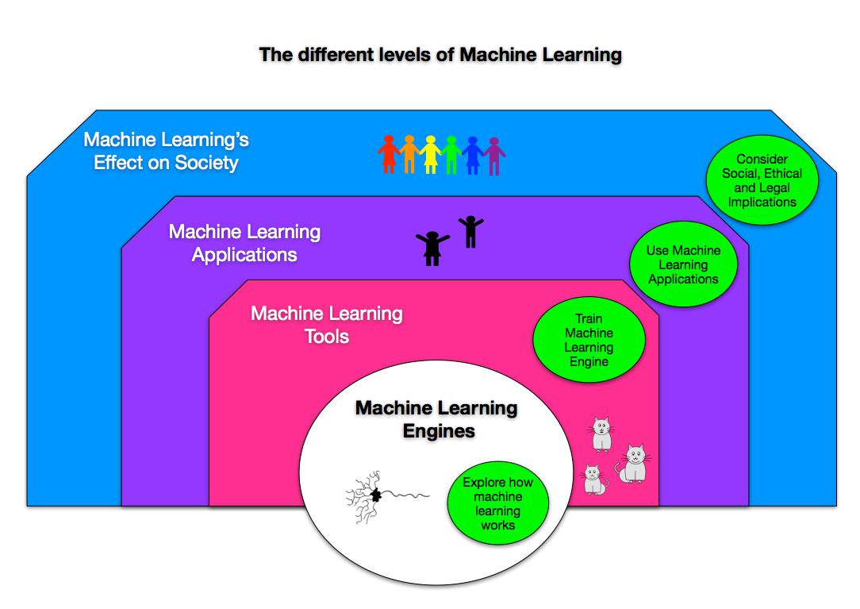
Everyone should be able to …

Slide 5
It is possible to introduce
machine learning ideas
in existing classroom activity

Slide 6
Understanding how Machine Learning works

Slide 7
It’s actually based on Biology
Understand the computing and biology together.
Deep Machine Learning is based on
Neural networks: based on how the brain works.
Other approaches …
Genetic Algorithms: based on evolution by natural selection.
Bayesian networks: based on causality / probability.

Slide 8
The Biology of
Machine Learning
A key thread through the science syllabus is understanding:
the senses
the nervous system
neurons and the brain
Don’t draw diagrams to teach this, create a computational model
create a brain that works (out of kids, rope and toilet roll)
Activity at teachinglondoncomputing.org/machine-learning/

Slide 9
First we need to understand how our brain works…

Slide 10
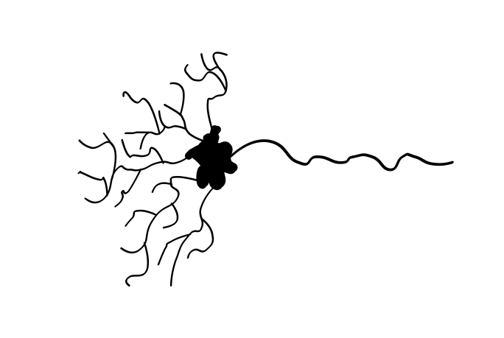
Each neuron follows a simple algorithm
Message out
to connected
neurons
Messages in from
connected neurons
Neuron fires only
when enough
messages have arrived

Slide 11

Its a bit like pumping up a balloon…

Slide 12

Signals in from
connected neurons

Slide 13

and it popping!
Messages in from
connected neurons
Neuron
fires on
some
threshold
Message out
to connected
neurons

Slide 14
Now let’s build a brain

Slide 15
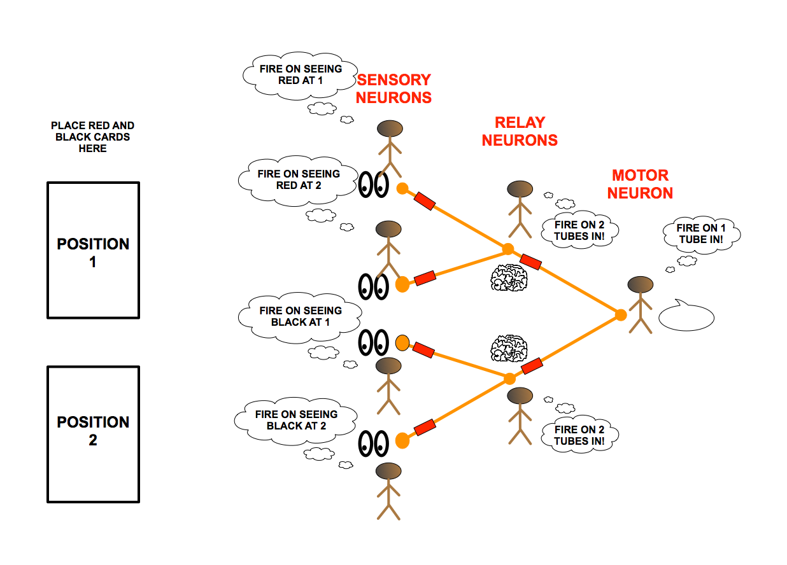
The brain-in-a-bag
(build a working brain from rope, tubes … and rules)

Slide 16
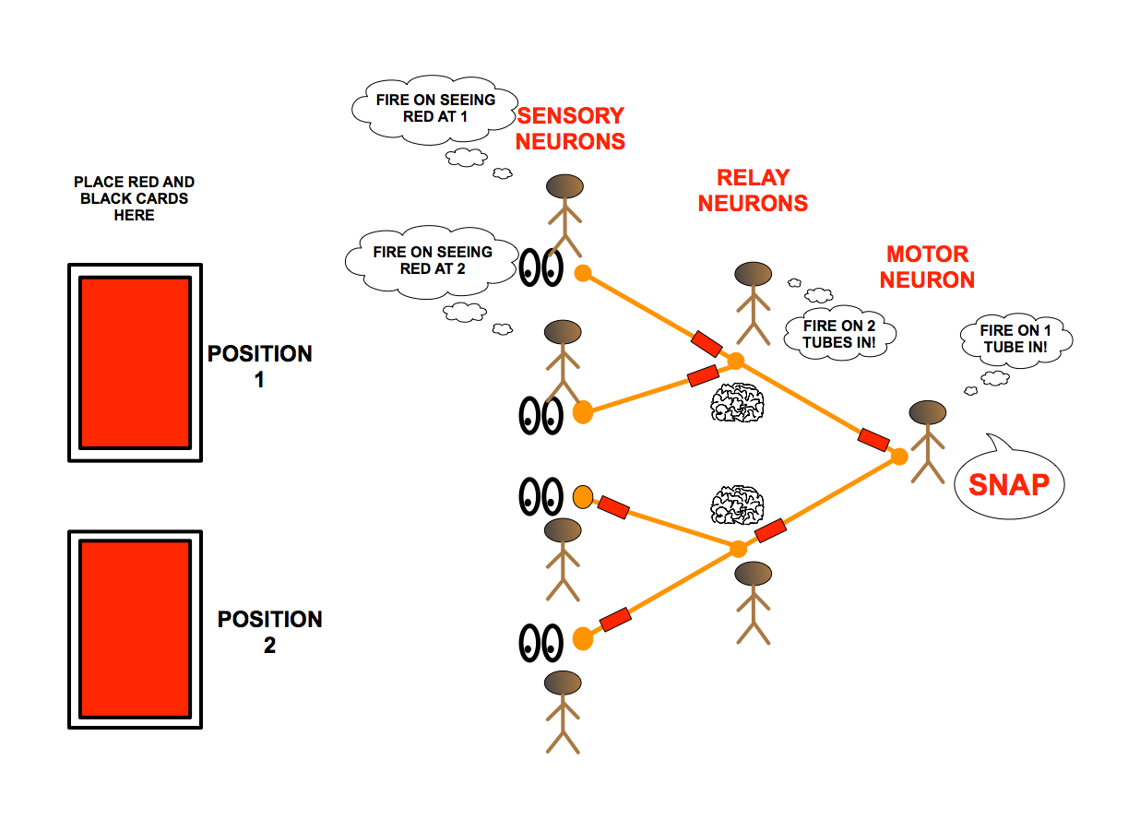
The brain in a bag
(build a working brain from kids, rope, tubes)

Slide 17
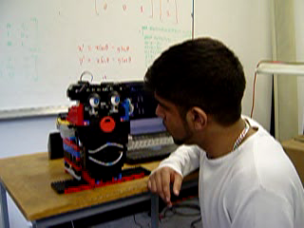
Exploring emotions with a robot with a neural network brain
1

Slide 18
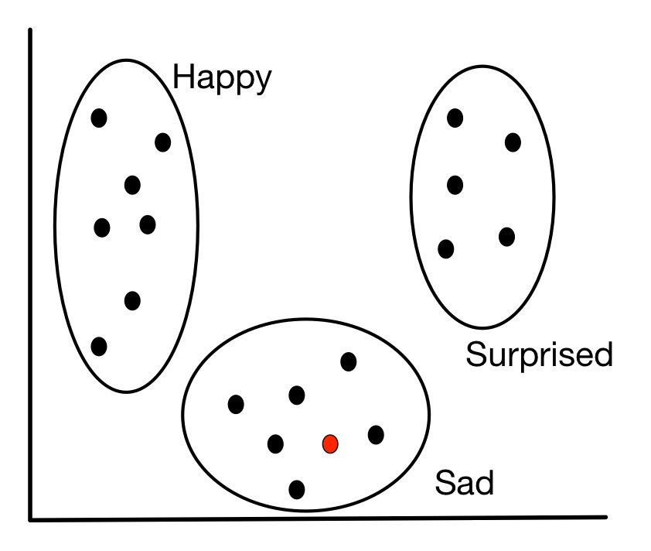
Spotting Patterns - its playing 20 Questions!

Slide 19
…but how can an algorithm learn

Slide 20
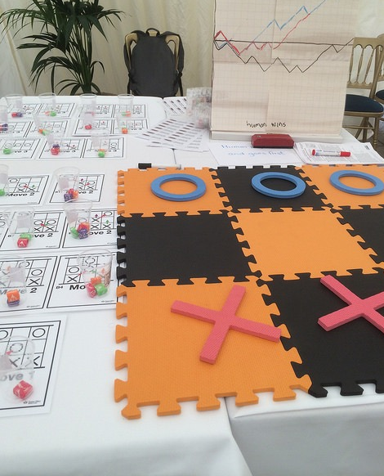
The Sweet Learning Computer
We will train a ‘machine’ made of cups and sweets to play the game of Hexapawn

Slide 21
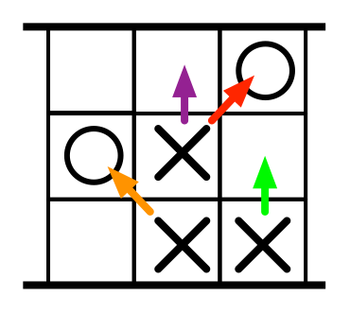
Hexapawn Moves
Move straight forward in to a free space
OR
Take Diagonally
www.teachinglondoncomputing.org

Slide 22
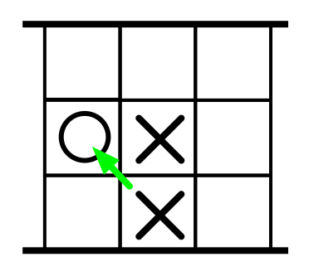
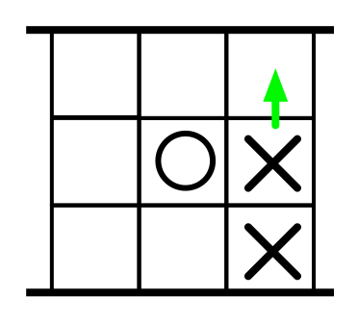
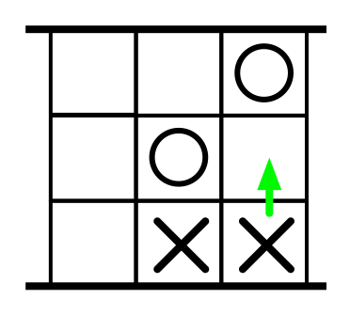
Hexapawn: Ways to Win
1. Take all other player’s pieces
2 Get a piece to the last row
3. Block other player from moving
www.teachinglondoncomputing.org

Slide 23
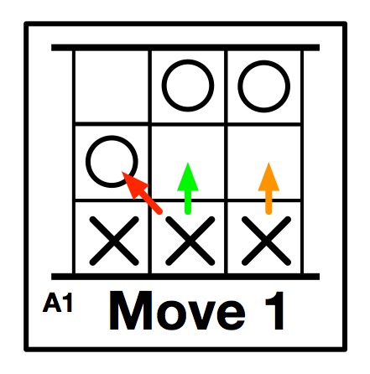
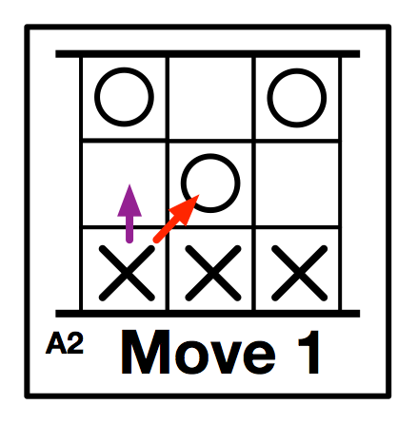
A Learning Machine
Set up
Lay out all the board positions
Put coloured sweets in a cup with each board matching the coloured arrows on that board
To play
Find the board picture matching the current state
Randomly take out a sweet from that cup and make the move of that coloured arrow
If lose or no move possible, eat the sweet of the last move made (it will never make that mistake again!)
www.teachinglondoncomputing.org

Slide 24
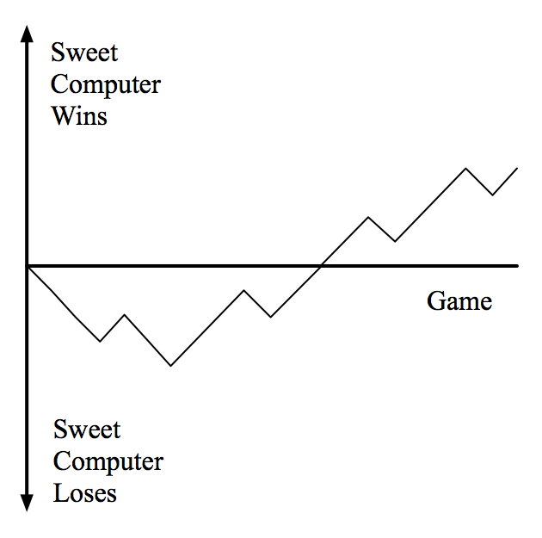
Plotting Progress Learning
Plot the progress of the machine:
Draw a downward line for a loss
Draw an upward line for a draw
www.teachinglondoncomputing.org

Slide 25
Understanding the ethical and societal issues

Slide 26
What do we want as a society?
Workshop activity: Discuss then rank scenarios into how desirable
An AI that detects brain tumours from scans
An AI that gathers information about people’s lifestyle and spots increasing health risks
and tells them? … and tells their GP?
An AI that spots potential benefit cheats and tells the authorities
An AI that scans prisoners’ backgrounds looking for early behavioural patterns that lead to crime
etc

Slide 27
Stereotypes, prejudice and discrimination
Machine Learning apps reflect society … even the bad bits!
A “Racist, homophobic” Chatbot on Twitter
A “Racist” prison sentencing program
What might be the issues of:
a program that identifies pregnant women from their shopping habits?
a program that identifies gay people from their face?
Rise of the (racist, sexist, homophobic,…) machines that support and encourage discrimination?

Slide 28
English
The societal, ethical and privacy issues behind Machine Learning and Big Data have potential for topics for writing fiction.
First read a selection of news/cs4fn articles about machine learning for inspiration.
Then write a story about the opportunities or consequences
For example, see the story “Robot” written for cs4fn at:
teachinglondoncomputing.org/computational-thinking-tales/

Slide 29
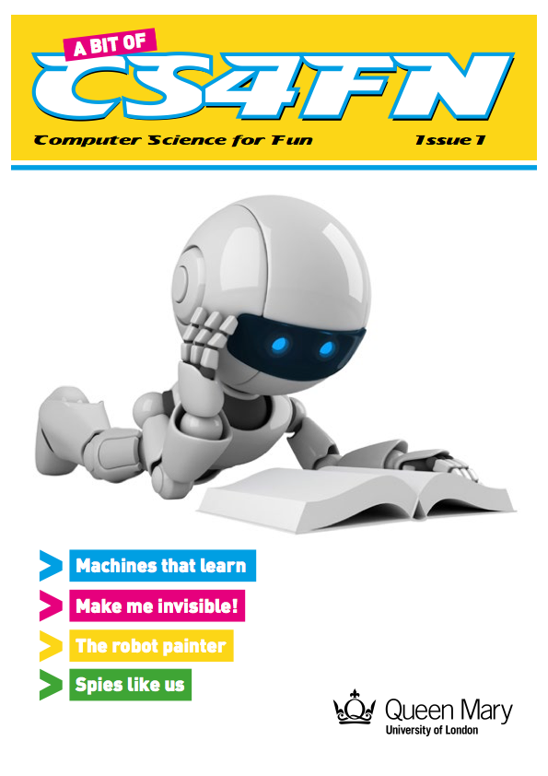
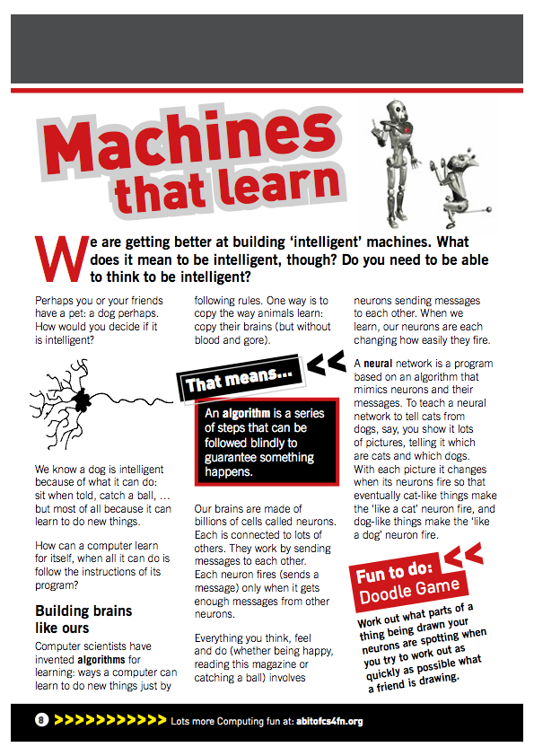
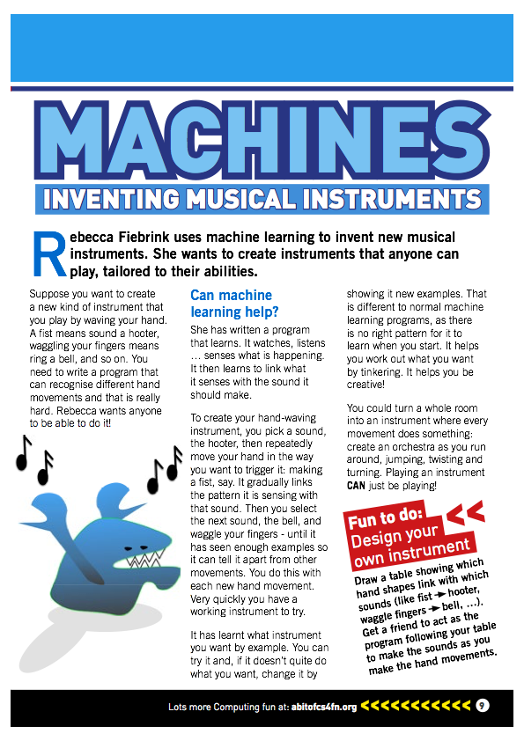
English / Literacy
Set reading about Machine Learning
We have been creating Computing reading resources for primary schools.
Including Machine Learning
e.g. ‘A Bit of CS4FN’ Magazine for younger students
Order free physical copies or download it from:
https://abitofcs4fn.org/magazine/

Slide 30
Justifying Decisions
A big issue (and open research question) here is that data driven machine learning cannot justify it’s decisions.
Why did it say you shouldn’t be interviewed for the job?
Was it because you are black? … or a woman? … gay?
Who knows what patterns it found and used?
Why does it say this person would be a good friend?
Bayesian Networks help. The causal model is open and inspectable. Justifications can be based on it.

Slide 31
Building and/or Using Machine Learning Tools

Slide 32
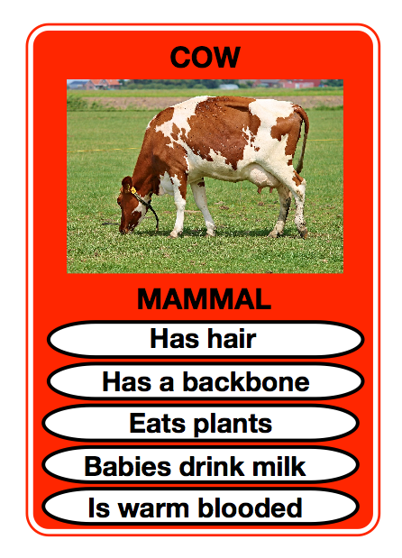
Doing Science / Classification
Classification of animals by features (KS2)
Train / Use a machine learning tool
eg toolset at machinelearningforkids.co.uk
Descriptions of features of animals as training
Actively explore what makes an animal a mammal using the tool and try to identify the features yourself
Or unplugged with animal cards & tally cups
What other topics could be explored this way?

Slide 33
Exploring Big Data Sets
Computational modelling provides a new way to do science …Machine Learning provides another:
Looking for patterns in massive data sets.
Students can do the same on topics on the syllabus
Any subject where understanding might be based on large amounts of data … explore public datasets
science
geography …

Slide 34
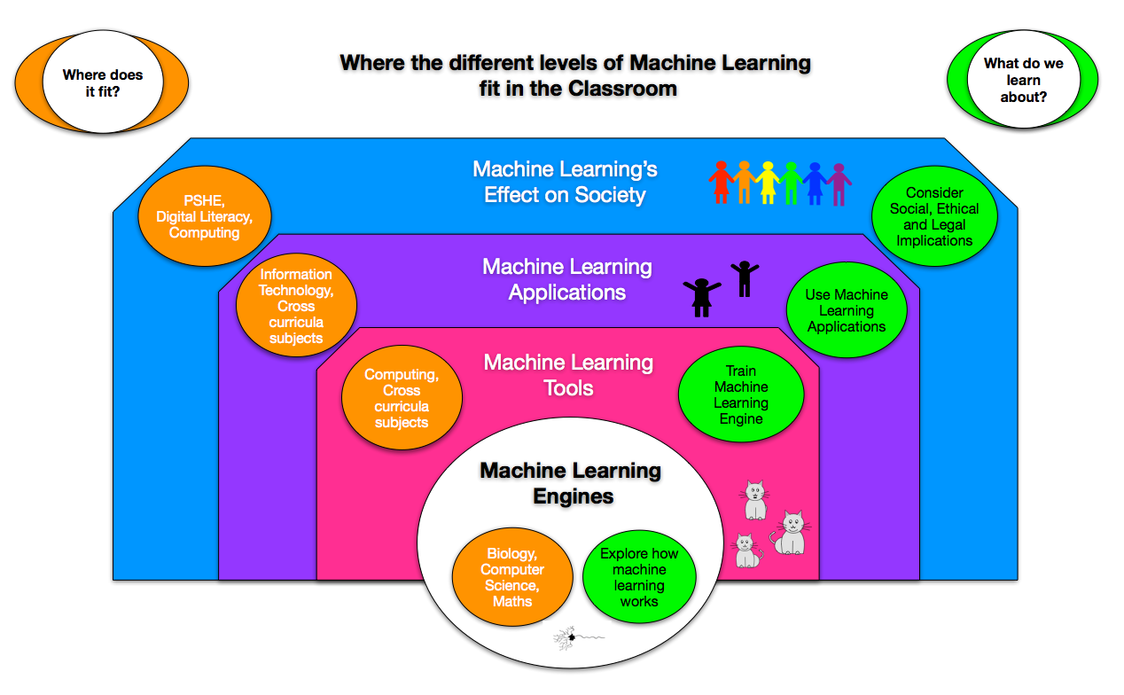
How might you include it in lessons?

Slide 35
Summary
There are lots of ways machine learning can be integrated in to and give support across the curriculum
Unplugged Computational Modelling …is a powerful way to teach science
Irrespective of links to Machine Learning!

Slide 36
Thank you
Lots of FREE resources and
teachinglondoncomputing.org/machine-learning
OR BUY OUR BOOK …which includes more on machine learning and AI

